Slide 1


Secure Messaging: End-to-End Encrypted Communication
The landscape of digital communication is evolving rapidly, emphasizing the need for secure and private messaging solutions. End-to-end encryption has emerged as a crucial safeguard in this dynamic environment, ensuring that messages are protected from unauthorized access and surveillance.

Slide 2
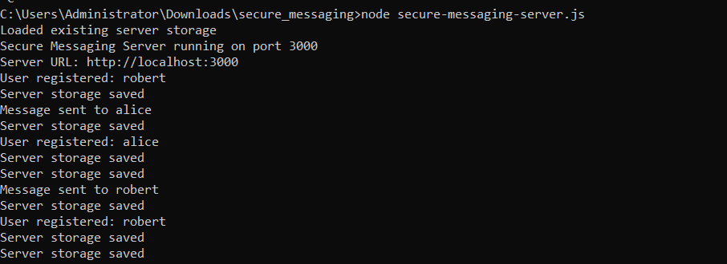
SecureChat: A Comprehensive Messaging System
Key Components
SecureChat's architecture is built on a foundation of robust security components, designed to provide a secure and user-friendly messaging experience. The system incorporates a client application with an intuitive interface, a central server for efficient message routing, and a core encryption module based on the widely trusted Signal Protocol. The system also features persistent session management for a seamless user experience, and a scalable architecture suitable for enterprise deployment.

Slide 3
Unlocking the Benefits of SecureChat
1
True Privacy
2
Forward Secrecy
SecureChat's end-to-end encryption ensures that only the intended recipients can read the messages. This eliminates the risk of unauthorized access or interception, providing users with complete control over their communications.
Even if a user's keys are compromised at a later time, past messages remain secure. This critical feature known as forward secrecy guarantees the confidentiality of past communications.
3
Verifiable Security
4
Cross-Platform Support
SecureChat's open architecture allows for independent security audits, enhancing transparency and user trust. The ability to verify the system's security practices is crucial for building confidence in the platform's reliability.
SecureChat operates seamlessly across various devices and operating systems, providing users with flexibility and convenience. This cross-platform compatibility ensures a consistent and reliable messaging experience across different environments.
5
Zero Knowledge
6
Persistent Security
The SecureChat server never has access to the contents of messages. This zero-knowledge principle ensures that the communication remains truly private, as the server is only responsible for routing encrypted messages.
SecureChat maintains encryption throughout the user's sessions. This persistent security guarantees that messages remain protected, even during restarts or interruptions in connectivity.

Slide 4




The Foundation of Secure Messaging
Key Generation
Each user begins by generating a unique cryptographic identity, consisting of a private and public key pair. This key pair forms the foundation of secure communication, ensuring that each user has a distinct identity.
Registration
The user's public key is registered with the SecureChat server. This registration allows users to find each other within the system securely and establish encrypted communication channels.
Verification
SecureChat employs security codes for verifying user identities. This process helps prevent imposters and ensures the authenticity of each participant in the communication.
Discovery
Users can securely find other users within the system, ensuring that the communication is established with the right individual. This feature promotes privacy and prevents unwanted interactions.

Slide 5
Securing Every Message: The Encryption Process
Session Establishment
SecureChat creates a secure channel between the communicating users, establishing a secure connection for their conversation.
Message Encryption
Each message is encrypted using session-specific keys. These keys are unique to the communication session, further strengthening the security of each message.
Key Ratcheting
SecureChat employs key ratcheting, where keys evolve with each message exchange, making it incredibly challenging to decipher past messages even if a key is compromised.
Message Authentication
SecureChat incorporates message authentication to verify the integrity of messages. This process ensures that messages haven't been altered or tampered with during transmission.
Secure Delivery
Encrypted messages are securely routed through the SecureChat server, ensuring that the communication remains protected during transit.

Slide 6
Safeguarding Your Data: Secure Storage
Local Encryption
Session Persistence
Minimal Metadata
Messages are stored locally on users' devices in an encrypted format, providing an additional layer of protection against unauthorized access, even if the device is compromised.
SecureChat ensures that encryption capabilities are maintained across restarts, guaranteeing that messages remain secure even after the device is rebooted or powered off.
SecureChat minimizes the collection of tracking information, limiting the amount of metadata associated with messages. This prioritizes user privacy and reduces the potential for unauthorized tracking.
Secure Deletion
Backup Protection
SecureChat offers users the option to expire messages after a specific time period. This feature allows users to manage the lifetime of their messages and ensure that sensitive data is deleted automatically.
SecureChat ensures that backups are also encrypted, providing an extra layer of security even if the user chooses to back up their data. This ensures that data is always protected, regardless of the storage method.

Slide 7
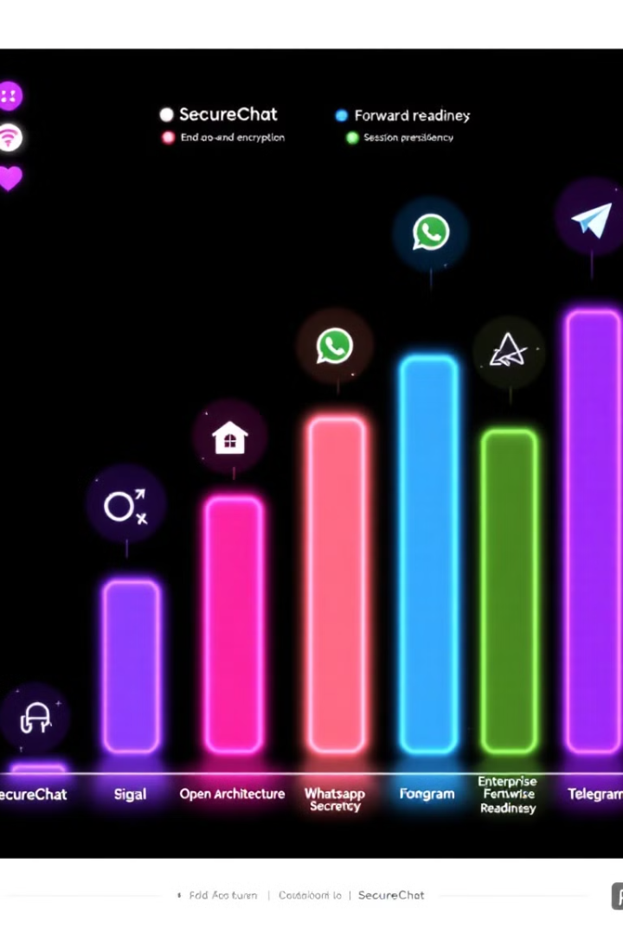
SecureChat vs. the Competition: A Comparative Analysis
Feature
SecureChat
Signal
WhatsApp
Telegram
End-to-End Encryption
✅
✅
✅
Optional
Open Architecture
✅
✅
❌
Partial
Forward Secrecy
✅
✅
✅
Limited
Enterprise Ready
✅
Limited
Limited
✅
Session Persistence
✅
✅
✅
Partial
Custom Deployment
✅
❌
❌
❌

Slide 8
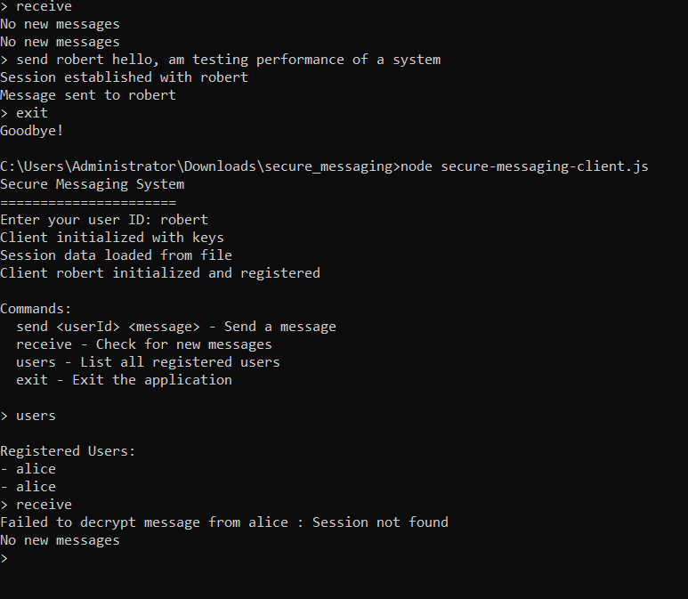
Deploying SecureChat: Flexible Options for Individuals and Enterprises
Enterprise Deployment
SecureChat offers a self-hosted server option for organizations seeking complete control over their communication infrastructure. This allows enterprises to customize security policies, retention rules, and access control mechanisms, ensuring compliance with their specific requirements.
Individual Use
SecureChat caters to individual users by providing a personal server option and a lightweight client-only version. This allows users to control their communication privacy without the complexity of server management. A cloud-hosted secure instance is also available, offering a convenient and readily accessible solution.

Slide 9






Navigating the Path to Secure Communication
Finding the right balance between security and convenience is crucial. SecureChat offers flexible deployment options, allowing users to choose the level of security that best suits their needs.
Key management is a fundamental aspect of security. SecureChat employs strong key management practices to ensure that keys are generated, stored, and used securely.
SecureChat may comply with regulatory requirements such as GDPR and HIPAA, ensuring that the system adheres to data privacy and security regulations.
User training is essential for ensuring that users understand the importance of secure communication practices and effectively use the system's security features.
Regular security updates are crucial for addressing vulnerabilities and maintaining the security of the system. SecureChat provides regular patches and updates to protect against evolving threats.
SecureChat emphasizes backup protocols, ensuring that user data is protected even in the event of device loss or data corruption. Backups are securely encrypted to maintain data privacy.

Slide 10

Conclusion: Embracing Secure Communication for a Safer Future
In today's digital landscape, where privacy and security are paramount, secure messaging solutions like SecureChat are essential. As individuals and organizations increasingly rely on digital communication, choosing the right secure messaging system is crucial for protecting sensitive information and safeguarding privacy.

